Slide 1
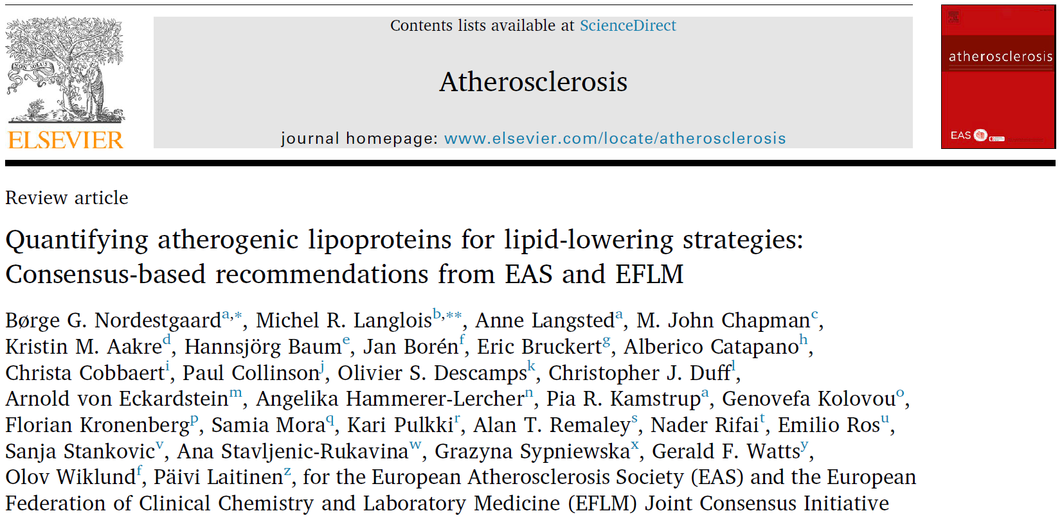


Jacob J Christensen
Clinical dietitian, PhD
National Advisory Unit on FH
Oslo University Hospital
Department of Nutrition

Slide 2
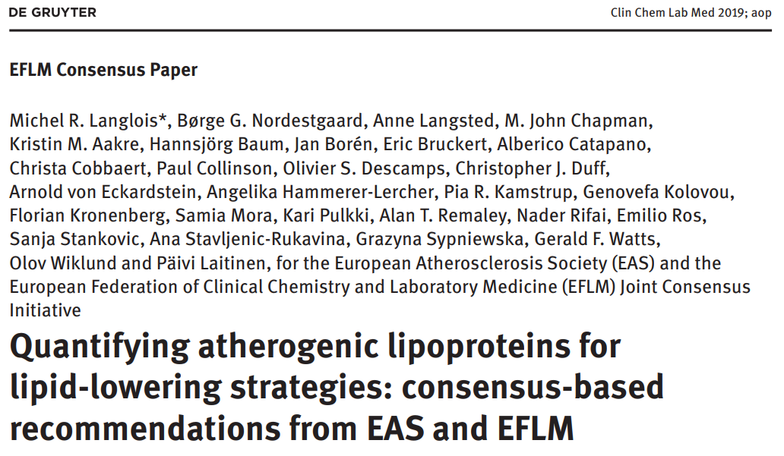
[Langlois MR Clin Chem Lab Med 2019]

Slide 3
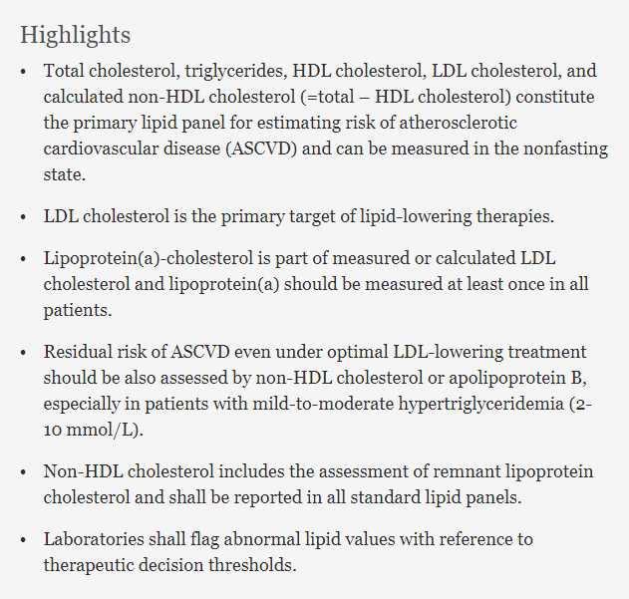
Primary lipid panel:
TC, TG, LDL-C, HDL-C,
non-HDL-C
(nonfasting state)
LDL-C guides LLT
Lp(a) once
Residual risk:
non-HDL-C or apoB
Non-HDL-C = remnant LPs
Flag abnormal values
[Nordestgaard BG Atherosclerosis 2020]

Slide 4
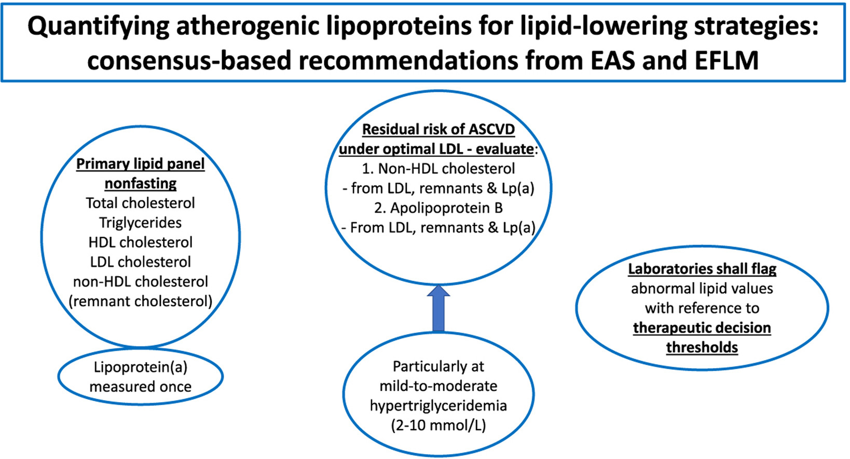
[Nordestgaard BG Atherosclerosis 2020]
Notes:
Abstract
The joint consensus panel of the European Atherosclerosis Society (EAS) and the European Federation of Clinical Chemistry and Laboratory Medicine (EFLM) recently addressed present and future challenges in the laboratory diagnostics of atherogenic lipoproteins. Total cholesterol, triglycerides, HDL cholesterol, LDL cholesterol, and calculated non-HDL cholesterol (=total – HDL cholesterol) constitute the primary lipid panel for estimating risk of atherosclerotic cardiovascular disease (ASCVD) and can be measured in the nonfasting state. LDL cholesterol is the primary target of lipid-lowering therapies. For on-treatment follow-up, LDL cholesterol shall be measured or calculated by the same method to attenuate errors in treatment decisions due to marked between-method variations. Lipoprotein(a)-cholesterol is part of measured or calculated LDL cholesterol and should be estimated at least once in all patients at risk of ASCVD, especially in those whose LDL cholesterol decline poorly upon statin treatment. Residual risk of ASCVD even under optimal LDL-lowering treatment should be also assessed by non-HDL cholesterol or apolipoprotein B, especially in patients with mild-to-moderate hypertriglyceridemia (2–10 mmol/L). Non-HDL cholesterol includes the assessment of remnant lipoprotein cholesterol and shall be reported in all standard lipid panels. Additional apolipoprotein B measurement can detect elevated LDL particle numbers often unidentified on the basis of LDL cholesterol alone. Reference intervals of lipids, lipoproteins, and apolipoproteins are reported for European men and women aged 20–100 years. However, laboratories shall flag abnormal lipid values with reference to therapeutic decision thresholds.

Slide 5
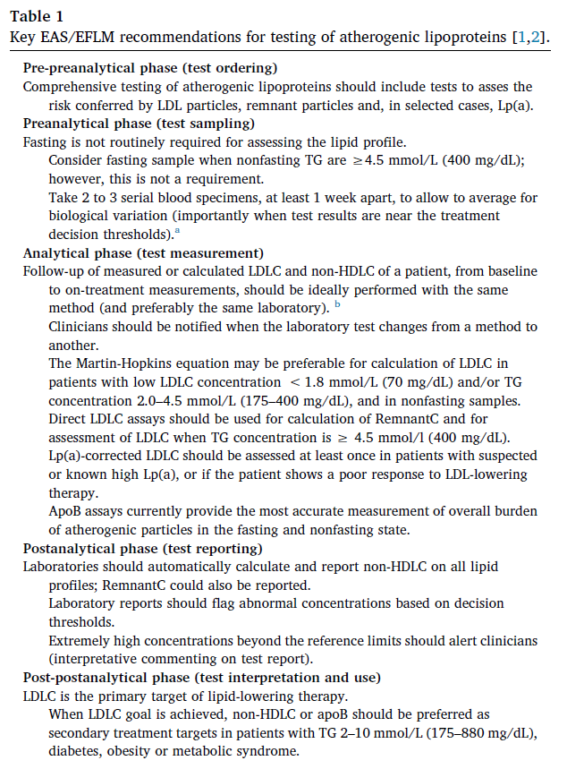
Assess LDL, remnant and Lp(a) particles
Ordering
Sampling
Fasting not required; consider when TG ≥ 4.5
When close to LLT decision threshold,
use average of 2-3 serial blood samples
Measurement
Use same method/laboratory
Friedewald vs Martin-Hopkins equation
Lp(a)-corrected LDL-C
Reporting
Flag abnormal values by decision thresholds
Interpretation
LDL-C primary target for LLT
non-HDL-C or apoB secondary targets
[Nordestgaard BG Atherosclerosis 2020]
Notes:
Table 1. Key EAS/EFLM recommendations for testing of atherogenic lipoproteins [1,2].
a
Avoid measurements within ~2 months after acute myocardial infarction, acute trauma, surgery, acute infection or inflammatory illness, or pregnancy. Patients should maintain their usual diet in the preceding 2 weeks, and avoid strenuous exercise.
b
Remove serum from cells (centrifugation) within 3 h of blood sampling, and perform lipid measurements within 1–2 days of collection. However, before measurement specimens can safely be stored at 4 °C for 3 days, at −20 °C for 1 month, and at −80 °C for 1–2 years.

Slide 6
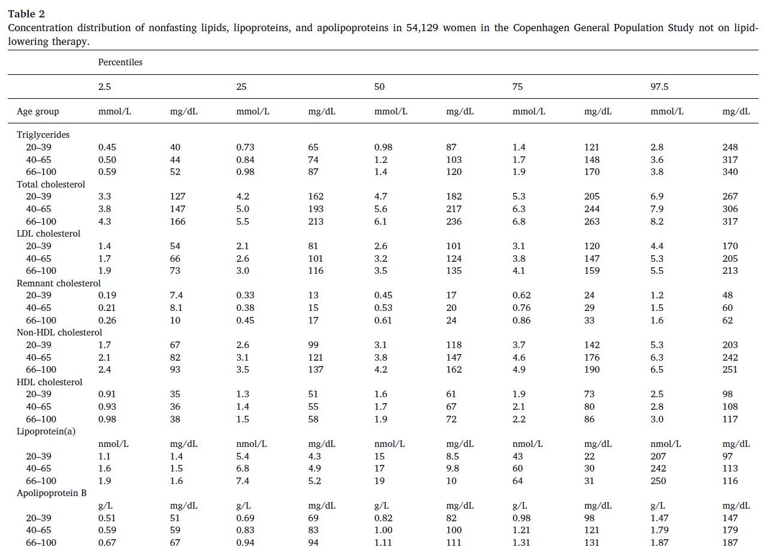
WOMEN
TG
TC
LDL-C
Remnant-C
Non-HDL-C
HDL-C
Lp(a)
ApoB
[Nordestgaard BG Atherosclerosis 2020]
Notes:
Table 2. Concentration distribution of nonfasting lipids, lipoproteins, and apolipoproteins in 54,129 women in the Copenhagen General Population Study not on lipid-lowering therapy.
Nonfasting triglycerides (TG), total cholesterol (TC), high-density lipoprotein cholesterol (HDLC), and apolipoprotein B concentrations were measured by automated assays (Thermo Scientific Konelab, Vantaa, Finland). Low-density lipoprotein cholesterol (LDLC) was calculated by the Friedewald equation when TG were <4 mmol/L and was measured directly (Konelab) when TG were ≥4 mmol/L. Non-HDL cholesterol was calculated as TC minus HDLC. Remnant cholesterol was calculated as TC minus LDLC minus HDLC. The first 5592 individuals included in the Copenhagen General Population Study had lipoprotein(a) total mass measured using a sensitive immunoturbidimetric assay from DiaSys (DiaSys Diagnostic Systems, Holzheim, Germany), while all remaining individuals in the study had lipoprotein(a) measurements done using the apolipoprotein(a) isoform insensitive Denka Seiken assay (Denka Seiken, Tokyo, Japan) or the Roche second generation lipoprotein(a) assay developed by Denka Seiken (Roche Diagnostics, Rotkreuz, Switzerland) [3].

Slide 7
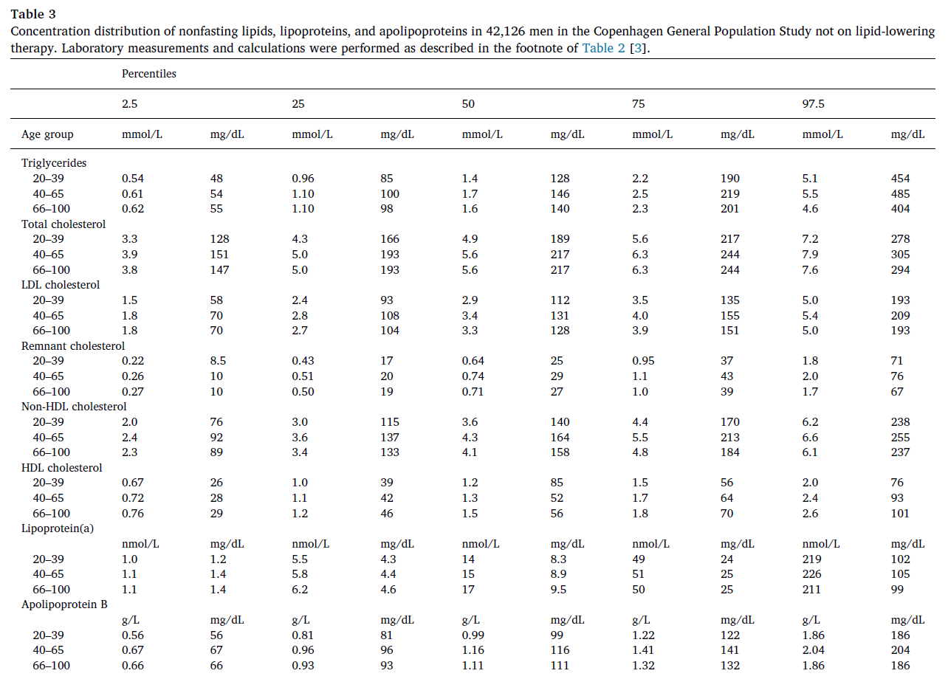
MEN
TG
TC
LDL-C
Remnant-C
Non-HDL-C
HDL-C
Lp(a)
ApoB
[Nordestgaard BG Atherosclerosis 2020]
Notes:
Table 3. Concentration distribution of nonfasting lipids, lipoproteins, and apolipoproteins in 42,126 men in the Copenhagen General Population Study not on lipid-lowering therapy. Laboratory measurements and calculations were performed as described in the footnote of Table 2 [3].

Slide 8
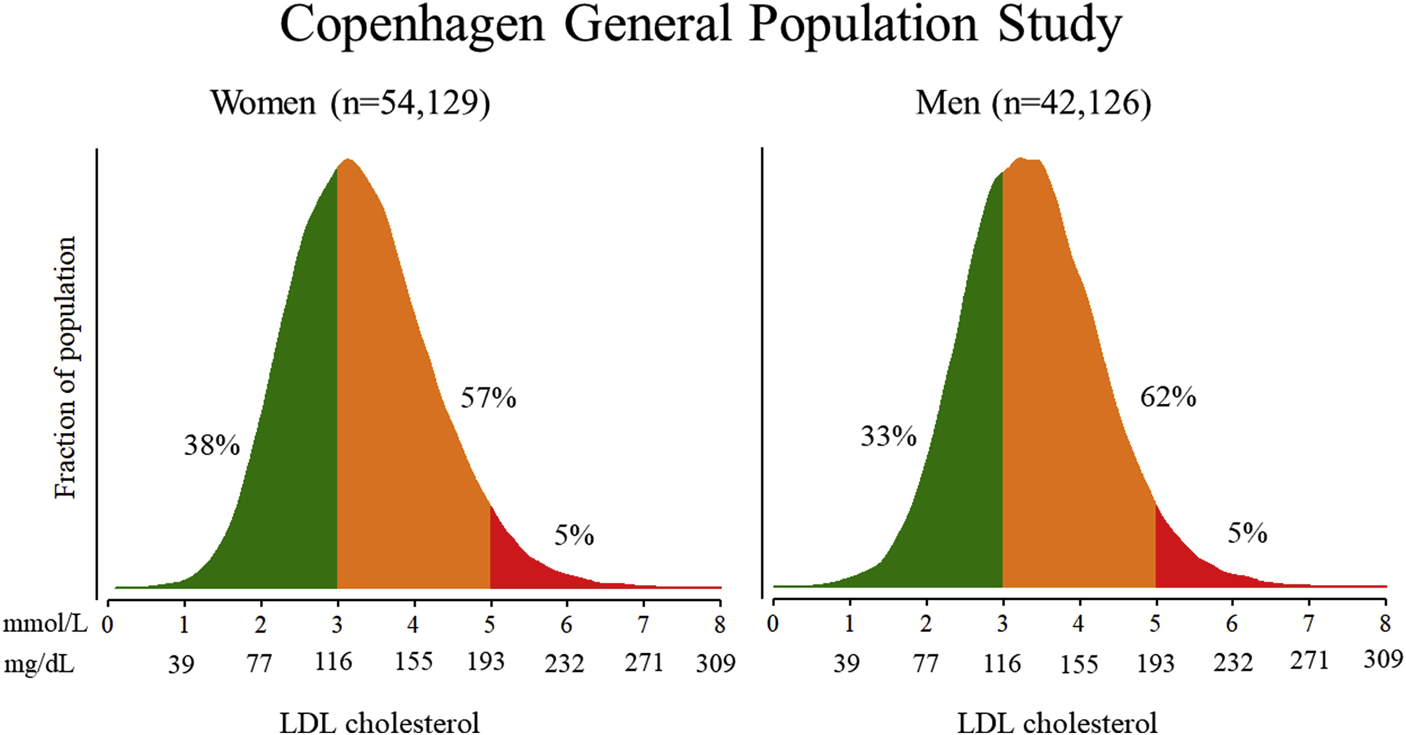
[Nordestgaard BG Atherosclerosis 2020]
Notes:
Fig. 2. Distribution of nonfasting LDLC concentration in men and women from the Copenhagen General Population Study not on lipid-lowering therapy.

Slide 9
Which atherogenic lipoproteins
should be measured?

Slide 10
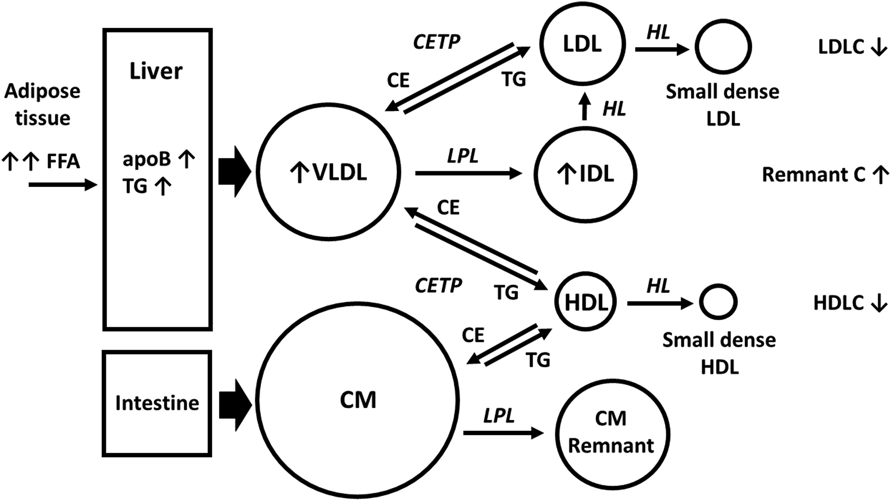
[Nordestgaard BG Atherosclerosis 2020]
Notes:
Fig. 1. Intravascular remodeling of lipoproteins contributing to the typical serum lipid profile of atherogenic dyslipidemia.

Slide 11
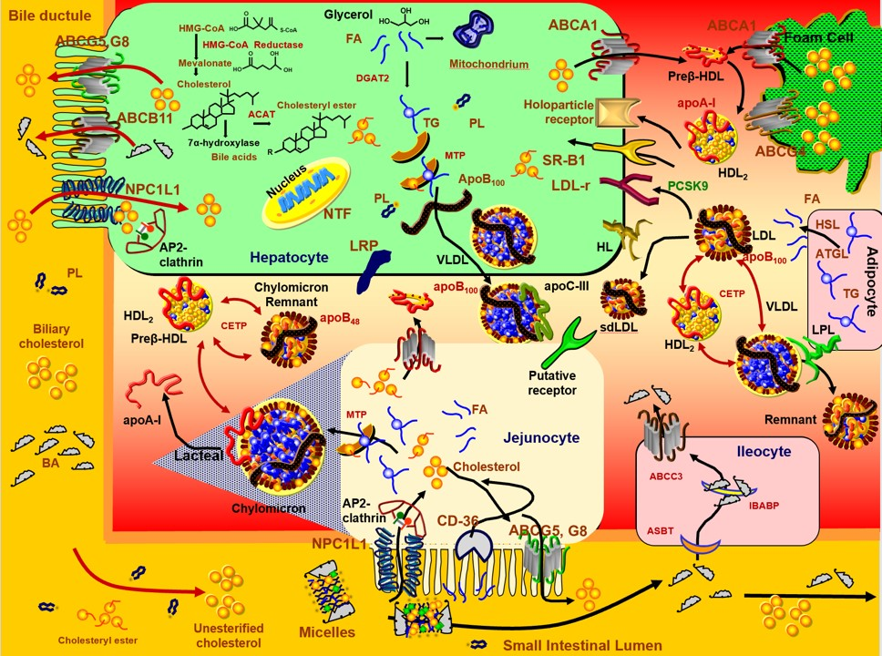
[Dayspring T, Twitter slide 12:10 AM Jan 9 2020

Slide 12
LDL particles
Remnant particles
Lp(a) particles
The key component
Size doesn’t matter
Ratios can be misleading
Residual risk?
Poor treatment effect?
Nonfasting state
Assays or calculation
KIV-2 repeats
Statins vs PCSK9i
Drugs coming
Non-HDL-C = TC – HDL-C = Remnant-C + LDL-C
Additional clinical information
Contains Lp(a)-C
Remnant-C = TC – HDL-C – LDL-C = Non-HDL-C – LDL-C
LDL-C should be ‘direct measurement’
If Friedewald: no additional clinical information
Does not contain Lp(a)-C
VLDL and IDL particles
[Nordestgaard BG Atherosclerosis 2020]

Slide 13
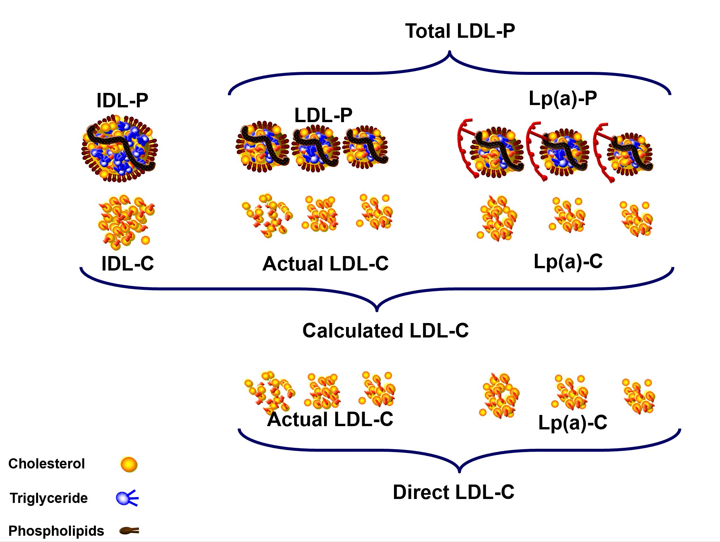
[Dayspring T, Twitter slide 1:12 AM Jan 11 2020]
Notes:
LDL metrics need to be better understood
What is difference between LDL-C & Lp(a)-C, calculated (Friedewald) & direct LDL-C?
NMR determined LDL-P includes Lp(a)-P: as it cannot distinguish the two.
Statins reduce LDL-C & LDL-P but not Lp(a)-C or Lp(a)-P

Slide 14
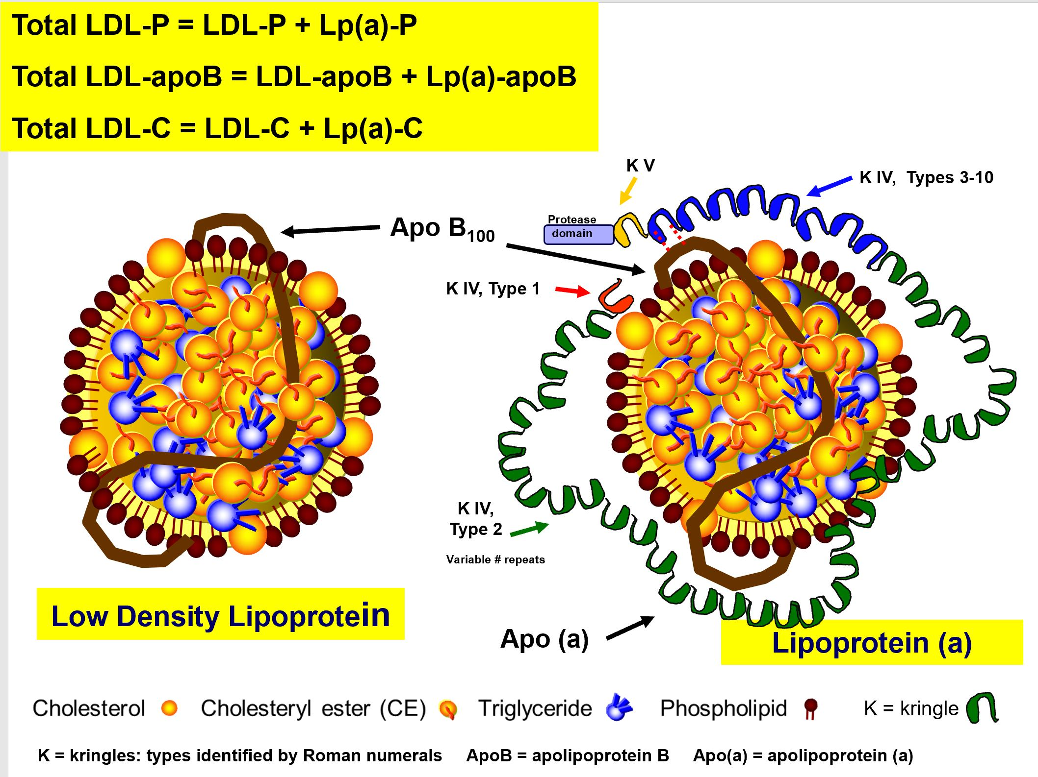
[Dayspring T, Twitter slide 2:47 PM Jan 25 2020]
Notes:
LDL metrics need to be better understood
What is difference between LDL-C & Lp(a)-C, calculated (Friedewald) & direct LDL-C?
NMR determined LDL-P includes Lp(a)-P: as it cannot distinguish the two.
Statins reduce LDL-C & LDL-P but not Lp(a)-C or Lp(a)-P

Slide 15
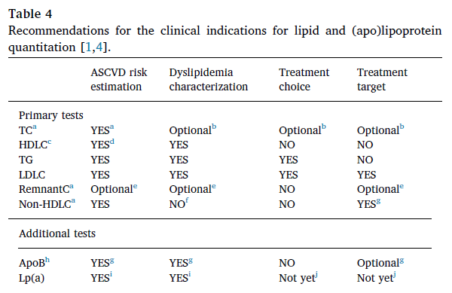
Comprehensive testing of Als should use a biomarker,
or panel of biomarkers, to assess risk of ASCVD
associated with LDL-p(and remnant and Lp(a)-p)
In the clinical setting
LDL-C
[Nordestgaard BG Atherosclerosis 2020]
Notes:
Table 4. Recommendations for the clinical indications for lipid and (apo)lipoprotein quantitation [1,4].
a
In nonfasting samples this will also include cholesterol in chylomicrons and their remnants; however, in the majority of individuals chylomicrons are rapidy converted into remnants (within 5–10 min) after delivery from lymphs to the blood stream.
b
To be considered in a minimal lipid profile (TC and TG only) or when LDLC is not available.
c
Or ApoA-I if available.
d
In combination with TC, if HDLC is entered as a separate variable in the risk estimation model. Ratios of TC/HDLC, non-HDLC/HDLC, or apoB/apoA-I which reflect the balance between atherogenic and neutral lipoproteins can be considered as an alternative for risk estimation, but not for diagnosis or as treatment targets. The components of the ratio have to be managed separately.
e
RemnantC, calculated as TC – HDLC – LDLC, is all cholesterol found in TG-rich lipoproteins VLDL, IDL, and, in the nonfasting state, additionally chylomicron remnants. RemnantC is included in non-HDLC, but non-HDLC does not differentiate between LDLC and RemnantC. RemnantC is the part of non-HDLC in addition to LDLC that needs reduction in some patients. Directly measured LDLC should preferably be used in the calculation of RemnantC, or RemnantC could be measured directly.
f
Non-HDLC, calculated as TC – HDLC, is all cholesterol in atherogenic lipoproteins: LDL, remnants, and Lp(a). None of the hyperlipidemias can be characterized by non-HDLC because the composite marker does not differentiate between the atherogenic lipoprotein-cholesterol fractions.
g
In patients with mild-to-moderate hypertriglyceridemia, 2–10 mmol/L (175–880 mg/dL), diabetes, obesity or metabolic syndrome.
h
Or advanced LDLP measurement if available.
i
At least once in each adult person's lifetime, especially in patients with premature ASCVD (men <55 years, women <60 years), family history of premature ASCVD and/or elevated Lp(a), FH, recurrent ASCVD despite optimal lipid-lowering treatment.
j
Unless approved treatment is available to substantially reduce Lp(a) concentration and Lp(a)-related risk.

Slide 16
What is the SLP?

Slide 17
The traditional lipid profile of TC, TG, LDL-C, and HDL-C
remains the primary approach for diagnosis
and ASCVD risk classification
LDL-C by Friedewald
Calculate
Mild-to-moderate hyperTGemia
At least once (premature ASCVD, aortic valve stenosis)
[Nordestgaard BG Atherosclerosis 2020]
Notes:
Table 4. Recommendations for the clinical indications for lipid and (apo)lipoprotein quantitation [1,4].
a
In nonfasting samples this will also include cholesterol in chylomicrons and their remnants; however, in the majority of individuals chylomicrons are rapidy converted into remnants (within 5–10 min) after delivery from lymphs to the blood stream.
b
To be considered in a minimal lipid profile (TC and TG only) or when LDLC is not available.
c
Or ApoA-I if available.
d
In combination with TC, if HDLC is entered as a separate variable in the risk estimation model. Ratios of TC/HDLC, non-HDLC/HDLC, or apoB/apoA-I which reflect the balance between atherogenic and neutral lipoproteins can be considered as an alternative for risk estimation, but not for diagnosis or as treatment targets. The components of the ratio have to be managed separately.
e
RemnantC, calculated as TC – HDLC – LDLC, is all cholesterol found in TG-rich lipoproteins VLDL, IDL, and, in the nonfasting state, additionally chylomicron remnants. RemnantC is included in non-HDLC, but non-HDLC does not differentiate between LDLC and RemnantC. RemnantC is the part of non-HDLC in addition to LDLC that needs reduction in some patients. Directly measured LDLC should preferably be used in the calculation of RemnantC, or RemnantC could be measured directly.
f
Non-HDLC, calculated as TC – HDLC, is all cholesterol in atherogenic lipoproteins: LDL, remnants, and Lp(a). None of the hyperlipidemias can be characterized by non-HDLC because the composite marker does not differentiate between the atherogenic lipoprotein-cholesterol fractions.
g
In patients with mild-to-moderate hypertriglyceridemia, 2–10 mmol/L (175–880 mg/dL), diabetes, obesity or metabolic syndrome.
h
Or advanced LDLP measurement if available.
i
At least once in each adult person's lifetime, especially in patients with premature ASCVD (men <55 years, women <60 years), family history of premature ASCVD and/or elevated Lp(a), FH, recurrent ASCVD despite optimal lipid-lowering treatment.
j
Unless approved treatment is available to substantially reduce Lp(a) concentration and Lp(a)-related risk.

Slide 18
When to use fasting
and nonfasting blood samples?

Slide 19
Generally not required
Consider when:
TG ≥ 4.5 mmol/L
Diagnosis and follow-up of:
Mixed hyperlipidemia
Isolated hyperTGemia
Starting hyperTGemic medications
Genetic predisposition
Recovering from hyperTGemic pancreatitis
Other lab tests require it
[Nordestgaard BG Atherosclerosis 2020]

Slide 20
Are LDLC measurements
or calculations reliable?

Slide 21
Beta-quantification is the US Centers of Disease
Control (CDC) Reference Method for LDL-C
LDL-C = TC – HDL-C – TG/adjustable-factor
Friedewald LDL-C is unreliable when… | Improve the reliability by using…
Very low LDL-C (<1.8 mmol/L) | Martin-Hopkins modified equation (not Friedewald)
Mild-to-moderate TG (2-4.5 mmol/L) | Martin-Hopkins modified equation (not Friedewald)
High TG (≥ 4-4.5 mmol/L) | Direct assay
Still sub-optimal:
diabetes,
kidney disease
The TG:cholesterol ratio is approximately 2.2 (for mmol/L values),
but increases when TG increases, resulting in underestimation of LDL-C
Lp(a)-corrected LDL-C (mmol/L) = LDL-C (mmol/L) – [Lp(a) (mg/dL) * 0.0078]
Conversion factors for nmol/L not available yet, due to size heterogeneity and cross-reactivity
[Nordestgaard BG Atherosclerosis 2020]

Slide 22
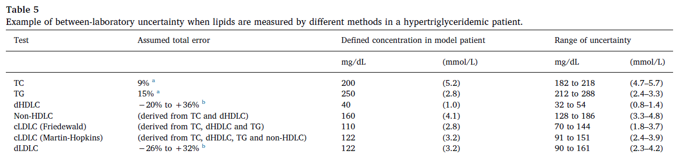
[Nordestgaard BG Atherosclerosis 2020]
Notes:
Table 5. Example of between-laboratory uncertainty when lipids are measured by different methods in a hypertriglyceridemic patient.
a
Based on National Cholesterol Education Program (NCEP) analytical performance criteria [41].
b
Total error ranges observed by Miller et al. [42] across different dLDLC and dHDLC methods in dyslipidemic samples. The total error combines systematic bias and random imprecision. The table is not relevant for the monitoring of a patient by the same laboratory/method over time. In this situation the bias remains constant and only the (inevitable) imprecision is relevant. Bias should ideally be ≤ 4% for LDLC and ≤5% for HDLC to allow the methods to meet the NCEP total error goals, ≤12% and ≤13%, respectively.

Slide 23
LDLC test errors:
are they clinically relevant?

Slide 24
Use the same method and laboratory for repeated
measures; use more than one sample to guide LLT
[Nordestgaard BG Atherosclerosis 2020]
Notes:
Table 5. Example of between-laboratory uncertainty when lipids are measured by different methods in a hypertriglyceridemic patient.
a
Based on National Cholesterol Education Program (NCEP) analytical performance criteria [41].
b
Total error ranges observed by Miller et al. [42] across different dLDLC and dHDLC methods in dyslipidemic samples. The total error combines systematic bias and random imprecision. The table is not relevant for the monitoring of a patient by the same laboratory/method over time. In this situation the bias remains constant and only the (inevitable) imprecision is relevant. Bias should ideally be ≤ 4% for LDLC and ≤5% for HDLC to allow the methods to meet the NCEP total error goals, ≤12% and ≤13%, respectively.

Slide 25
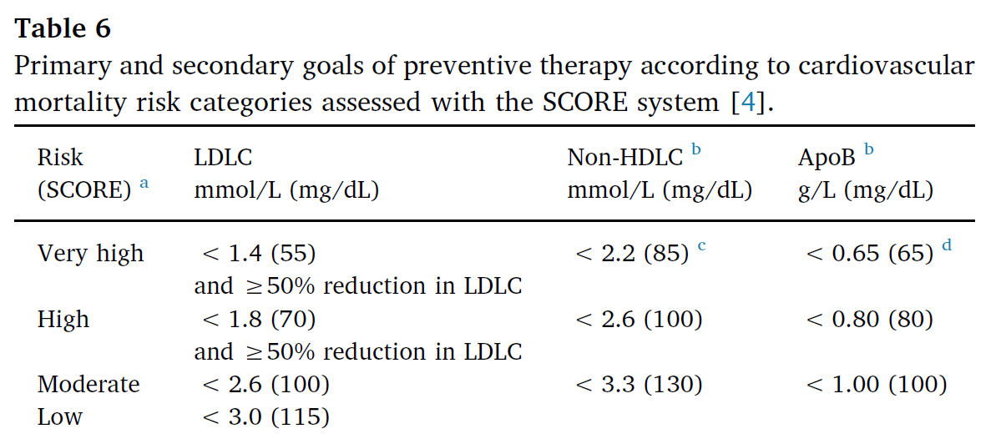
[Nordestgaard BG Atherosclerosis 2020]
Notes:
Table 6. Primary and secondary goals of preventive therapy according to cardiovascular mortality risk categories assessed with the SCORE system [4].
Very high risk = documented ASCVD, diabetes with target organ damage (proteinuria, retinopathy or neuropathy), or early onset type 1 diabetes of >20 years duration, severe chronic kidney disease (GFR <30 mL/min/1.73 m2), SCORE ≥10%; High risk = TC > 8 mmol/L (310 mg/dL), LDLC >5 mmol/L (190 mg/dL), FH, hypertension ≥180/110 mmHg, diabetes of ≥10 years duration without target organ damage, moderate chronic kidney disease (GFR 30–59 mL/min/1.73 m2), SCORE ≥5% and<10%.
Moderate risk = young patients with diabetes (type 1 < 35 years, type 2 < 50 years) of <10 years duration, SCORE ≥1% and<5%.
Low risk = SCORE <1%.
To convert mmol/L to mg/dL, multiply with 38.6 for LDL and non-HDL cholesterol.
a
10-year risk of fatal ASCVD as estimated using SCORE (Systematic COronary Risk Evaluation) [4].
b
Secondary target in patients with mild-to-moderate hypertriglyceridemia, 2–10 mmol/L (175–880 mg/dL) including those with obesity or metabolic syndrome, diabetes, or chronic kidney disease.
c
Discordant high non-HDLC at optimal LDLC goal reflects elevated RemnantC >0.8 mmol/L (30 mg/dL).
d
Discordant high apoB at optimal LDLC goal reflects elevated numbers of small, cholesterol-depleted LDL particles.

Slide 26
Are other measurements of
atherogenic lipoproteins reliable?

Slide 27
More comprehensive (LDL-C, Lp(a), Remnant-C)
Lack of discrimination can hide residual risk
Superior to LDL-C and non-HDL-C
Use with TG 2-10 mmol/L, obesity, DM, MetS, or LDL-C < 1.8 mmol/L
Stable, nonfasting OK, unaffected by TGs
[Nordestgaard BG Atherosclerosis 2020]
Notes:
Table 6. Primary and secondary goals of preventive therapy according to cardiovascular mortality risk categories assessed with the SCORE system [4].
Very high risk = documented ASCVD, diabetes with target organ damage (proteinuria, retinopathy or neuropathy), or early onset type 1 diabetes of >20 years duration, severe chronic kidney disease (GFR <30 mL/min/1.73 m2), SCORE ≥10%; High risk = TC > 8 mmol/L (310 mg/dL), LDLC >5 mmol/L (190 mg/dL), FH, hypertension ≥180/110 mmHg, diabetes of ≥10 years duration without target organ damage, moderate chronic kidney disease (GFR 30–59 mL/min/1.73 m2), SCORE ≥5% and<10%.
Moderate risk = young patients with diabetes (type 1 < 35 years, type 2 < 50 years) of <10 years duration, SCORE ≥1% and<5%.
Low risk = SCORE <1%.
To convert mmol/L to mg/dL, multiply with 38.6 for LDL and non-HDL cholesterol.
a
10-year risk of fatal ASCVD as estimated using SCORE (Systematic COronary Risk Evaluation) [4].
b
Secondary target in patients with mild-to-moderate hypertriglyceridemia, 2–10 mmol/L (175–880 mg/dL) including those with obesity or metabolic syndrome, diabetes, or chronic kidney disease.
c
Discordant high non-HDLC at optimal LDLC goal reflects elevated RemnantC >0.8 mmol/L (30 mg/dL).
d
Discordant high apoB at optimal LDLC goal reflects elevated numbers of small, cholesterol-depleted LDL particles.

Slide 28
Can apoB measurement replace
the SLP for monitoring of LLT?

Slide 29
Should non-HDLC or apoB
be used as additional tests to LDLC
in lipid-lowering strategies?

Slide 30
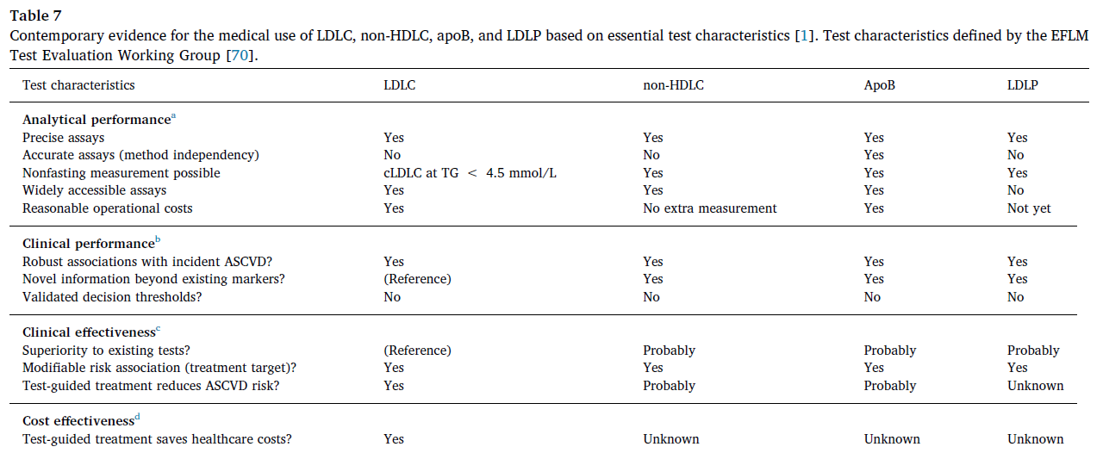
It is still unclear if ApoB can replace the SLP, but it is still
a highly valuable add-on measurement
for certain patients and to evaluate therapeutic response
[Nordestgaard BG Atherosclerosis 2020]
Notes:
Table 7. Contemporary evidence for the medical use of LDLC, non-HDLC, apoB, and LDLP based on essential test characteristics [1]. Test characteristics defined by the EFLM Test Evaluation Working Group [70].
a
Analytical validity: ability of the test to conform to predefined quality specifications to measure the marker of interest.
b
Diagnostic or prognostic accuracy: ability of the test to consistently discriminate patients with increased risk from those with lower risk for developing ASCVD.
c
Clinical utility: ability of the test to improve health outcomes of the patient under standard clinical care.
d
Health-economic advantage of introducing the test in medical practice (value for money).

Slide 31
How to report
the atherogenic lipid profiles?

Slide 32
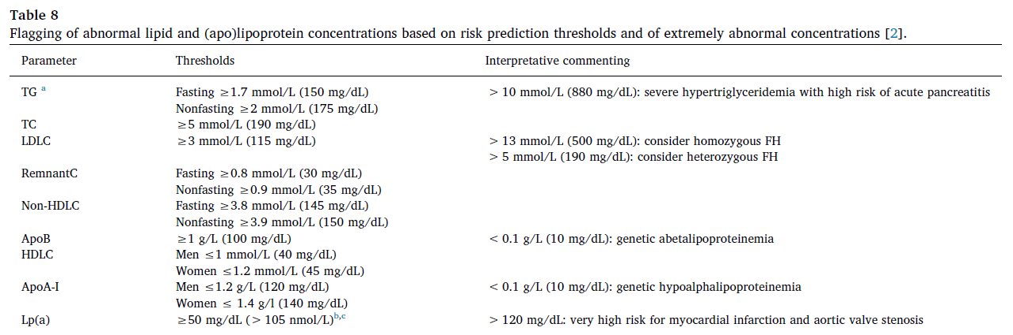
Flag lipid profiles by decision thresholds (in children also
by reference values)
[Nordestgaard BG Atherosclerosis 2020]
Notes:
Table 8. Flagging of abnormal lipid and (apo)lipoprotein concentrations based on risk prediction thresholds and of extremely abnormal concentrations [2].
Values in mmol/L were converted to mg/dL by multiplication with 38.6 for cholesterol and 88.5 for TG, followed by rounding to the nearest 5 mg/dL.
a
TG thresholds based on assays with correction for endogenous glycerol. The free glycerol concentration in a sample, usually 1 mg/dL, equivalent to ~10 mg/dL (0.11 mmol/L) of TG, can be ignored. Increased baseline glycerol concentrations can be found in patients with diabetes and chronic kidney disease and during intravenous lipid infusion, and TG may be wrongly flagged in these patients unless glycerol-corrected TG assay is used.
b
Threshold value for Lp(a) should represent ≥80th percentile of the population-specific Lp(a) assay.
c
There is no consensus on which threshold value in mmol/L to be used for Lp(a); however, for conversion of Lp(a) concentrations in mg/dL to nmol/L, 13930 individuals from the Copenhagen General Population Study had measurements in both mg/dL and nmol/L by Denka Seiken assays distributed by Roche Diagnostics (Rotkreuz, Switzerland). The correlation was done by linear regression with an R2 value of 0.996, and the conversion was done by the following equation: Lp(a), nmol/L = 2.18*Lp(a), mg/dL–3.83 [3].

Slide 33
[Nordestgaard BG Atherosclerosis 2020]
Notes:
Table 6. Primary and secondary goals of preventive therapy according to cardiovascular mortality risk categories assessed with the SCORE system [4].
Very high risk = documented ASCVD, diabetes with target organ damage (proteinuria, retinopathy or neuropathy), or early onset type 1 diabetes of >20 years duration, severe chronic kidney disease (GFR <30 mL/min/1.73 m2), SCORE ≥10%; High risk = TC > 8 mmol/L (310 mg/dL), LDLC >5 mmol/L (190 mg/dL), FH, hypertension ≥180/110 mmHg, diabetes of ≥10 years duration without target organ damage, moderate chronic kidney disease (GFR 30–59 mL/min/1.73 m2), SCORE ≥5% and<10%.
Moderate risk = young patients with diabetes (type 1 < 35 years, type 2 < 50 years) of <10 years duration, SCORE ≥1% and<5%.
Low risk = SCORE <1%.
To convert mmol/L to mg/dL, multiply with 38.6 for LDL and non-HDL cholesterol.
a
10-year risk of fatal ASCVD as estimated using SCORE (Systematic COronary Risk Evaluation) [4].
b
Secondary target in patients with mild-to-moderate hypertriglyceridemia, 2–10 mmol/L (175–880 mg/dL) including those with obesity or metabolic syndrome, diabetes, or chronic kidney disease.
c
Discordant high non-HDLC at optimal LDLC goal reflects elevated RemnantC >0.8 mmol/L (30 mg/dL).
d
Discordant high apoB at optimal LDLC goal reflects elevated numbers of small, cholesterol-depleted LDL particles.

Slide 34
[Nordestgaard BG Atherosclerosis 2020]
Notes:
Fig. 2. Distribution of nonfasting LDLC concentration in men and women from the Copenhagen General Population Study not on lipid-lowering therapy.

Slide 35
Conclusions
and future research priorities

Slide 36
Primary lipid panel:
TC, TG, LDL-C, HDL-C,
non-HDL-C
(nonfasting state)
LDL-C guides LLT
Lp(a) once
Residual risk:
non-HDL-C or apoB
Non-HDL-C = remnant LPs
Flag abnormal values
[Nordestgaard BG Atherosclerosis 2020]

